Slide 1
SDE, ODE/
Score-based Modeling
Diffusion Seminar (Week5)
Woojin Kim
AIDAS LAB
Seoul National University
wjk9904@snu.ac.kr

Slide 2
Table of contents
1
Recap: DDPM
2
DDIM: Denoising Diffusion Implicit Models
3
Score-based Modeling: Diffusion as SDE/ODE

Slide 3
Recap: DDPM
(Denoising Diffusion Probabilistic Models)

Slide 4







DDPM: Denoising Diffusion Probabilistic Models
1. DDPM Recab
Objective
To learn a generative process that reverses a fixed noising process, progressively denoising pure noise into realistic data samples.
$$q(x_{0})$$
$$q(x_{1})$$
$$q(x_{2})$$
$$…$$
$$q(x_{T−1})$$
$$q(x_{T})$$
Image Credit: Jihwan Hong

Slide 5
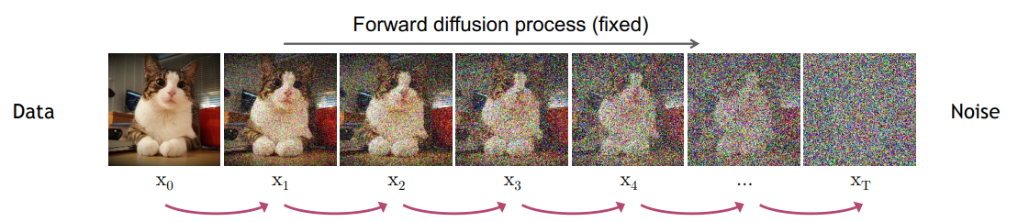
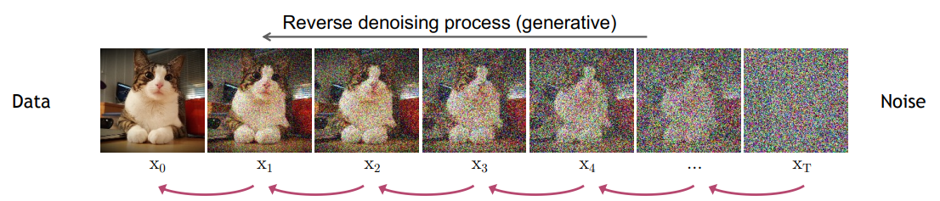

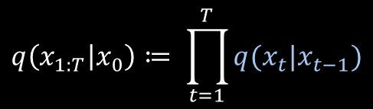
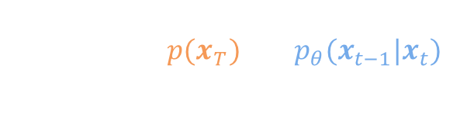

DDPM: Denoising Diffusion Probabilistic Models
1. DDPM Recab
Forward (noising) process
$$q\left(x_{1:T} | x_{0}\right)≔ \prod_{t=1}^{T}{q(x_{t}|x_{t−1})}$$
$$q\left(x_{t} | x_{t−1}\right)≔ 𝒩(x_{t};\sqrt{1−β_{t}}x_{t−1},β_{t}I)$$
Backward (denoising) process
$$p_{θ}(x_{0:T})≔p(x_{T})\prod_{t=1}^{T}{p_{θ}(x_{t−1}|x_{t})}$$
$$p\left(x_{T}\right)≔𝒩(x_{T};0,I)$$
$$p_{θ}\left(x_{t−1} | x_{t}\right)≔ 𝒩(x_{t−1},μ_{θ}\left(x_{t}, t\right),Σ_{θ}\left(x_{t},t\right))$$
Image Credit: Copyright (c) 2023 cvpr2023-tutorial-diffusion-models (MIT license)

Slide 6
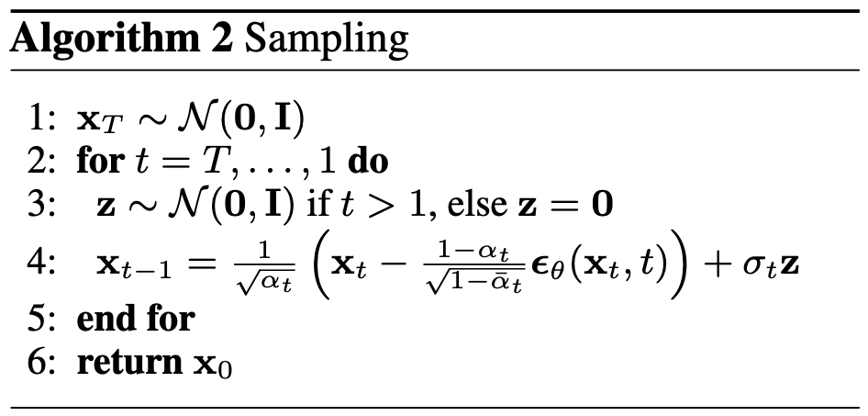

DDPM: Denoising Diffusion Probabilistic Models
1. DDPM Recab
Loss function
$$𝔼_{x_{0}, ε∼𝓝\left(0,I\right), t}\left[\frac{β_{t}^{2}}{2σ_{t}^{2}α_{t}\left(1−{\overline{α}}_{t}\right)}|| (ε−ε_{θ}(\sqrt{\overline{α_{t}}}x_{0}+\sqrt{\left(1−\overline{α_{t}}\right)}ε, t))||^{2}\right]$$
Original Loss:
Discard the weighting term
$$𝔼_{x_{0}, ε∼𝓝\left(0,I\right), t}\left[|| (ε−ε_{θ}(\sqrt{\overline{α_{t}}}x_{0}+\sqrt{\left(1−\overline{α_{t}}\right)}ε, t))||^{2}\right]$$
Simple Loss:
Sampling
Ref: Ho et al., “Denoising Diffusion Probabilistic Models”, NeurIPS 2020.

Slide 7




DDPM: Denoising Diffusion Probabilistic Models
1. DDPM Recab
Notable Properties
a. Markovian forward/backward process
$$q\left(x_{1:T} | x_{0}\right)≔ \prod_{t=1}^{T}{q(x_{t}|x_{t−1})}$$
$$p_{θ}(x_{0:T})≔p(x_{T})\prod_{t=1}^{T}{p_{θ}(x_{t−1}|x_{t})}$$
b. Variance preserving forward pass
$$q\left(x_{t} | x_{t−1}\right)≔ 𝒩(x_{t};\sqrt{1−β_{t}}x_{t−1},β_{t}I)$$
$$Var\left(x_{t−1}\right)=I, Var\left(x_{t}\right)=\left(1−β_{t}\right)I+β_{t}I=I$$
c. Arbitrary Timesteps at Training
$$q\left(x_{t} | x_{t−1}\right)≔ 𝒩(x_{t};\sqrt{1−β_{t}}x_{t−1},β_{t}I)$$
$$q\left(x_{t} | x_{0}\right)=𝒩\left(x_{t}; \sqrt{\overline{α_{t}}}x_{0},\left(1−\overline{α_{t}}\right)I\right)$$

Slide 8
DDIM: Denoising Diffusion Implicit Models

Slide 9
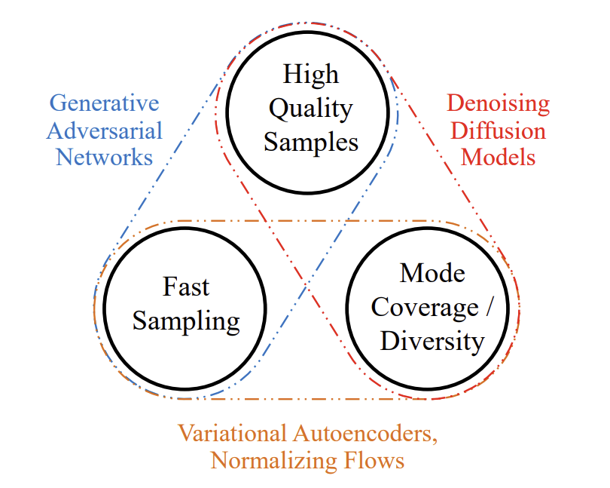
Generative Learning Trilemma
2. DDIM
Image credit: Xiao et al., “Tackling the generative learning trilemma with denoising diffusion gans”, ICLR 2022.

Slide 10
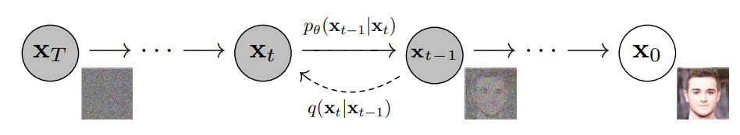


DDPM sampling is slow
2. DDIM
$$q\left(x_{1:T} | x_{0}\right)≔ \prod_{t=1}^{T}{q(x_{t}|x_{t−1})}$$
Forward/Reverse is both Markovian
Requires many iterations (~1000 steps)
$$p_{θ}(x_{0:T})≔p(x_{T})\prod_{t=1}^{T}{p_{θ}(x_{t−1}|x_{t})}$$
To arrive at pure noise, a sufficient amount of noise must be injected
If noise per step is too high, Gaussian approximation of the reverse posterior breaks
Can we make this faster without retraining?
Ref: Ho et al., “Denoising Diffusion Probabilistic Models”, NeurIPS 2020.
Image credit: Xiao et al., “Tackling the generative learning trilemma with denoising diffusion gans”, ICLR 2022.

Slide 11




Matching the Marginal
2. DDIM
Recall
$${L_{r}=𝔼}_{x_{0}, ε∼𝓝\left(0,I\right), t}\left[|| (ε−ε_{θ}(\sqrt{\overline{α_{t}}}x_{0}+\sqrt{\left(1−\overline{α_{t}}\right)}ε, t))||^{2}\right]$$
$$x_{t}$$
$$where x_{t}\sim q(x_{t}|x_{0})$$
Loss term only depends on the marginal, not the joint
There exists many different inference trajectories that share the same marginal
Marginal: $q(x_{t}|x_{0})$
src
tgt
Joint: $q(x_{1:t}|x_{0})$
Then, which trajectory should we sample from?

Slide 12




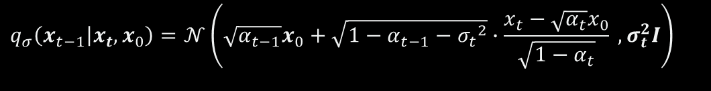

Non-Markovian Forward Process
2. DDIM
DDPM transition
$$q\left(x_{t} | x_{t−1}\right)≔ 𝒩(x_{t};\sqrt{1−β_{t}}x_{t−1},β_{t}I)$$
Assume there exists a family $Q$ of inference distributions
$$q_{σ\left(x_{1:t} | x_{0}\right)}≔q_{σ}\left(x_{T} | x_{0}\right)\prod_{t=2}^{T}{q_{σ}(x_{t−1}|x_{t},x_{0})}$$
Notation
$$α_{t}\left(DDIM\right)=\overline{α_{t}} in DDPM$$
$$q_{σ}\left(x_{t} | x_{0}\right)=𝒩\left(\sqrt{α_{t}}x_{0},\left(1−α_{t}\right)I\right)$$
Marginal:
$$q_{σ}\left(x_{t−1} | {x_{t}, x}_{0}\right)=𝒩\left(\sqrt{α_{t−1}}x_{0}+\sqrt{{1−α}_{t−1}−{σ_{t}}^{2}}∙\frac{x_{t}−\sqrt{α_{t}}x_{0}}{\sqrt{1−α_{t}}} , σ_{t}^{2}I\right)$$
Let posterior:
This leads to the above marginal (proof with induction)
$q_{σ}\left(x_{t} | {x_{t−1}, x}_{0}\right)= \frac{q_{σ}\left(x_{t−1}|x_{t}, x_{0}\right)q_{σ}(x_{t}|x_{0})}{q_{σ}(x_{t−1}|x_{0})}$
Forward process:
-> This is non-markovian since it depends on both $x_{t−1}, x_{0}$
Ref: Song et al., “Denoising Diffusion Implicit Models”, ICLR 2021.

Slide 13



Generative Process
2. DDIM
Then, what should the generative process be?
$$q_{σ}\left(x_{t−1} | {x_{t}, x}_{0}\right)=𝒩\left(\sqrt{α_{t−1}}x_{0}+\sqrt{{1−α}_{t−1}−{σ_{t}}^{2}}∙\frac{x_{t}−\sqrt{α_{t}}x_{0}}{\sqrt{1−α_{t}}} , σ_{t}^{2}I\right)$$
Posterior:
$x_{t}$is known, first find $x_{0}$
Recall
$$Predicted x_{0} ≔f_{θ}\left(x_{t}\right)≔(x_{t} − \sqrt{1−α_{t}}∙ε_{θ}\left(x_{t}\right))/\sqrt{α_{t}}$$
$x_{t}=$ $\sqrt{α_{t}}x_{0}+\sqrt{\left(1−α_{t}\right)}ε_{t}$
Generative process from $p_{θ}\left(x_{T}\right)=N (0, I)$
$$p_{θ}\left(x_{t−1}|x_{t}\right)=\left\{\begin{aligned}N(f_{θ}\left(x_{1}\right), σ_{1}^{2}I if t=1 \\ q_{σ}(x_{t−1}|x_{t}, f_{θ}\left(x_{t}\right)) otherwise\end{aligned}\right.$$
Training objective $J_{σ}\left(ε_{θ}\right)$ is almost same as the one in DDPM simplified objective ($L_{simple})$
(For detailed proof, see the paper)
Ref: Song et al., “Denoising Diffusion Implicit Models”, ICLR 2021.

Slide 14



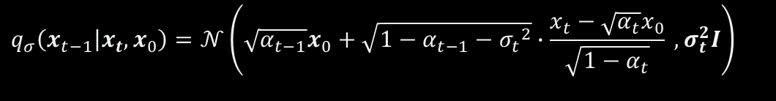



Denoising Diffusion Implicit Models
2. DDIM
$$q_{σ}\left(x_{t−1} | {x_{t}, x}_{0}\right)=𝒩\left(\sqrt{α_{t−1}}x_{0}+\sqrt{{1−α}_{t−1}−{σ_{t}}^{2}}∙\frac{x_{t}−\sqrt{α_{t}}x_{0}}{\sqrt{1−α_{t}}} , σ_{t}^{2}I\right)$$
Posterior:
$$p_{θ}\left(x_{t−1}|x_{t}\right)=\left\{\begin{aligned}N(f_{θ}\left(x_{1}\right), σ_{1}^{2}I) if t=1 \\ q_{σ}(x_{t−1}|x_{t}, f_{θ}\left(x_{t}\right)) otherwise\end{aligned}\right.$$
Transition:
$$x_{t−1}= \sqrt{α_{t−1}}\left(\frac{x_{t}−\sqrt{1−α_{t}}ε_{θ}\left(x_{t}\right)}{\sqrt{α_{t}}}\right)+\sqrt{1−α_{t−1}−σ_{t}^{2}}ε_{θ}\left(x_{t}\right)+σ_{t}ε_{t}$$
Sampled $x_{t−1}$:
Predicted $x_{0}$
Direction toward $x_{t}$
$${∗d}_{t}=x_{t}− \sqrt{α_{t}}x_{0}= \sqrt{1−α_{t}}ε_{t}$$
Ref: Song et al., “Denoising Diffusion Implicit Models”, ICLR 2021.

Slide 15
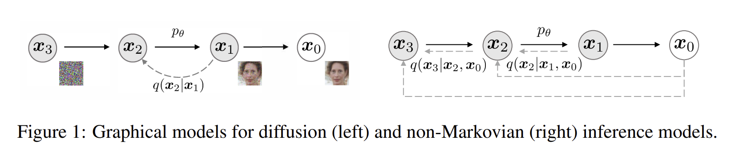



Comparison with DDPM
2. DDIM
Sampled $x_{t−1}$:
$$x_{t−1}= \sqrt{α_{t−1}}\left(\frac{x_{t}−\sqrt{1−α_{t}}ε_{θ}\left(x_{t}\right)}{\sqrt{α_{t}}}\right)+\sqrt{1−α_{t−1}−σ_{t}^{2}}ε_{θ}\left(x_{t}\right)+σ_{t}ε_{t}$$
DDPM sampling
When $σ_{t}=0$, forward process becomes deterministic (not stochastic)
$$x_{t−1}= \sqrt{α_{t−1}}\left(\frac{x_{t}−\sqrt{1−α_{t}}ε_{θ}\left(x_{t}\right)}{\sqrt{α_{t}}}\right)+\sqrt{1−α_{t−1}}ε_{θ}\left(x_{t}\right)$$
When $σ_{t}= \sqrt{(1−α_{t−1})/(1−α_{t})}\sqrt{1−α_{t}/α_{t−1}}$, process is same as DDPM
Ref: Song et al., “Denoising Diffusion Implicit Models”, ICLR 2021.

Slide 16
Score-based Modeling: Diffusion as SDE/ODE

Slide 17
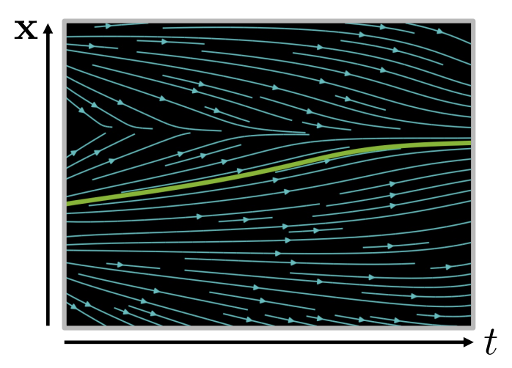
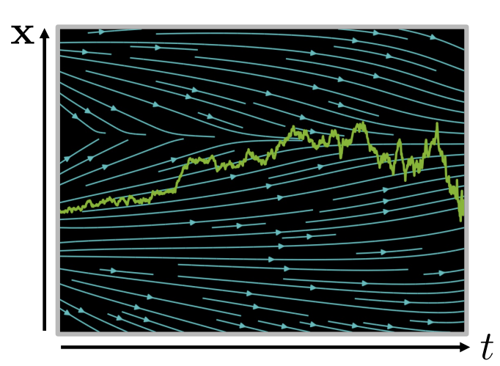




Preliminaries: ODE/SDE
3. Score-based Modeling
ODE: Ordinary differential equation
SDE: Stochastic differential equation
$$\frac{dx}{dt}=f(x, t)$$
$$\frac{dx}{dt}=μ\left(x, t\right)+σ\left(x, t\right)ω_{t}$$
Drift
term
Diffusion
term
Random
Process
Solution: $x\left(t\right)=x_{0}+\int_{o}^{t}{f\left(x\left(s\right), s\right) ds}$
Solution: $x\left(t\right)=x_{0}+\int_{o}^{t}{μ\left(x\left(s\right), s\right) ds}+ \int_{0}^{t}{σ\left(x\left(s\right), s\right) dω_{s}}$
Image Credit: Copyright (c) 2023 cvpr2023-tutorial-diffusion-models (MIT license)

Slide 18







Preliminaries: Euler’s method
3. Score-based Modeling
For ordinary differential equations, a typical solution can be written in the form of an integral.
$$\frac{dx}{dt}=f(x, t)$$
Solution: $x\left(t\right)=x_{0}+\int_{o}^{t}{f\left(x\left(s\right), s\right) ds}$
However, solving the integral can be challenging, so we often resort to approximation methods.
We begin by discretizing the function into small steps and then use these to approximate the next value
Real Solution
$$x\left(t_{k+1}\right)=x\left(t_{k}\right)+f(x(t_{k}),t_{k})∆t$$
Tangent line
$${f(x(t_{0}),t}_{0})$$
$$∆t$$
Approx.
-> This is the Euler’s method
$$t_{0}$$
$$t_{1}$$

Slide 19




Preliminaries: Euler-Maruyama method
3. Score-based Modeling
Similarly, for stochastic differential equations, we should solve an integral to get the solution
$$\frac{dx}{dt}=μ\left(x, t\right)+σ\left(x, t\right)ω_{t}$$
Solution: $x\left(t\right)=x_{0}+\int_{o}^{t}{μ\left(x\left(s\right), s\right) ds}+ \int_{0}^{t}{σ\left(x\left(s\right), s\right) dω_{s}}$
For simplicity, we again discretize into small step size and then approximate
$$x\left(t_{k+1}\right)=x\left(t_{k}\right)+μ\left(x\left(t_{k}\right),t_{k}\right)∆t+σ\left(x\left(t_{k}\right),t_{k}\right)∆ω$$
$ω_{t}$ is a Wiener process which $∆ω \sim N(0, ∆tI)$
Wiener process: models the random, continuous motion of a particle in Brownian motion.
Path is continuous
(Almost surely)
Independent
Increment
$$ω\left(0\right)=0$$
$$ω\left(t+∆t\right)−ω(t)=∆ω \sim N(0, ∆tI)$$

Slide 20



Preliminaries: Fokker-Planck Equation
3. Score-based Modeling
In physics, the Fokker-Planck equation describes how the probability density of a particle’s position evolves over time under stochastic dynamics.
$$\frac{dp(x,t)}{dt}=−∇\left(μ\left(x,t\right)p\left(x,t\right)\right)+∇^{2}(σ(x,t)∙p\left(x,t\right))$$
$p(x,t)$ = probability density
$μ(x,t)$ = drift term
$σ(x,t)$ = diffusion term
Over time, the Fokker-Planck process may converge to a stationary distribution $p^{∗}(x)$
$$\frac{dp^{∗}(x,t)}{dt}=0$$
In the machine learning perspective, we can think of this as designing a stochastic process such that its stationary distribution matches the data distribution $p_{data}(x)$

Slide 21

Preliminaries: Langevin dynamics
3. Score-based Modeling
Langevin dynamics describes the motion of a particle under both deterministic forces and random noise.
We can use it to simulate samples from the stationary distribution of the Fokker–Planck equation.
General Langevin equation:
$$dx\left(t\right)=−∇U\left(x\left(t\right)\right)dt+ \sqrt{2D}dω(t)$$
Corresponding Fokker-Planck:
$$\frac{dp(x,t)}{dt}=∇\left(∇U\left(x\left(t\right)\right)p\left(x,t\right)\right)+∇^{2}(D∙p\left(x,t\right))$$

Slide 22






Preliminaries: Langevin dynamics
3. Score-based Modeling
General Langevin equation:
$$dx\left(t\right)=−∇U\left(x\left(t\right)\right)dt+ \sqrt{2D}dω(t)$$
Corresponding Fokker-Planck:
$$\frac{dp(x,t)}{dt}=∇\left(∇U\left(x\left(t\right)\right)p\left(x,t\right)\right)+∇^{2}(D∙p\left(x,t\right))$$
Stationary distribution:
$$\frac{dp(x,t)}{dt}=0$$
$$p^{∗}\left(x\right)∝\exp{(\frac{−U\left(x\right)}{D})}$$
If we choose $D= \frac{1}{2}, U\left(x\right)=− \frac{1}{2}∇\log{p(x)}$
$$p^{∗}\left(x\right)∝\exp\left(\frac{∇\log{p(x)}/2}{1/2}\right)=p(x)$$
Think of $p(x$) as data distribution we want to target
Stationary distribution matches our target distribution!

Slide 23

Preliminaries: Langevin dynamics
3. Score-based Modeling
Generative SDE we wish to solve !
$$dx\left(t\right)=\frac{1}{2}∇\log{p(x)}dt+ dω(t)$$
Score function
Noise
Score function = gradient of the log-probability density
= direction in which the density increases fastest at point 𝑥

Slide 24
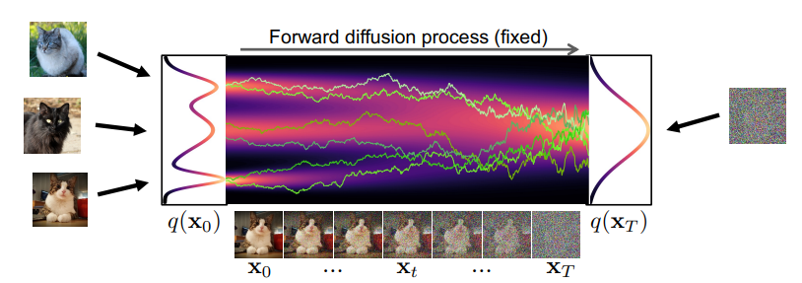






Diffusion as SDE
3. Score-based Modeling
Recall: DDPM forward
$$q\left(x_{t} | x_{t−1}\right)≔ 𝒩(x_{t};\sqrt{1−β_{t}}x_{t−1},β_{t}I)$$
$$x_{t+1}= \sqrt{1−β_{t+1}}x_{t}+ \sqrt{β_{t+1}}ε$$
Let $t= \frac{i}{T} ∈\left[0,1\right],$Assume the step size $∆t= \frac{1}{T}$
$$x_{t+∆t}= \sqrt{1−β(t)∆t}x_{t}+ \sqrt{β(t)}ε$$
$$x_{t+∆t}=(1−\frac{1}{2}β\left(t\right)∆t)x_{t}+ \sqrt{β(t)∆t}ε$$
(1st order Taylor expansion)
$$x_{t+∆t} −x_{t}=−\frac{1}{2}β\left(t\right)∆tx_{t}+ \sqrt{β(t)∆t}ε$$
Image Credit: Copyright (c) 2023 cvpr2023-tutorial-diffusion-models (MIT license)

Slide 25


Diffusion as SDE
3. Score-based Modeling
$$x_{t+∆t} −x_{t}=−\frac{1}{2}β\left(t\right)∆tx_{t}+ \sqrt{β(t)∆t}ε$$
$$dx(t)= −\frac{1}{2}β\left(t\right)x(t)dt+ \sqrt{β\left(t\right)}dω(t)$$
(Wiener process property)
SDE for diffusion forward process

Slide 26
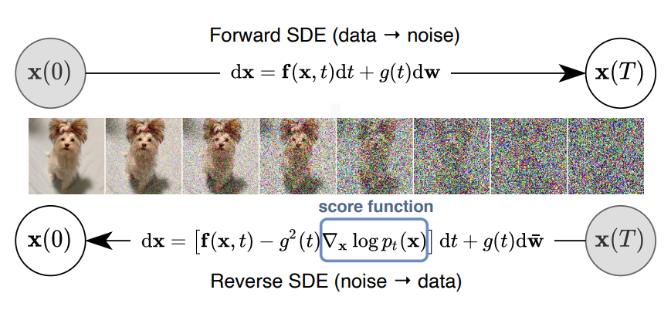

Diffusion as SDE
3. Score-based Modeling
Forward SDE
$$dx(t)= −\frac{1}{2}β\left(t\right)x(t)dt+ \sqrt{β\left(t\right)}dω(t)$$
Reverse SDE
$$dx\left(t\right)=[−\frac{1}{2}β\left(t\right)x\left(t\right)−β\left(t\right)∇_{x}\log{q_{t}\left(x\left(t\right)\right)}]dt+ \sqrt{β\left(t\right)}d\overline{ω}(t)$$
Score Function
Ref: Song et al., “SCORE-BASED GENERATIVE MODELING THROUGH STOCHASTIC DIFFERENTIAL EQUATIONS”, ICLR 2021.

Slide 27
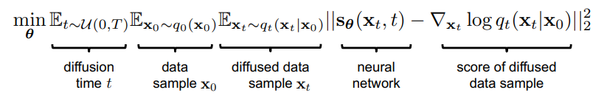

Score Matching
3. Score-based Modeling
$$∇_{x}\log{q_{t}\left(x\left(t\right)\right)}$$
Calculating the score function
This marginal is intractable
Diffused $q_{t}\left(x\left(t\right)|x(0)\right) is tractable$
Slide Credit: Copyright (c) 2023 cvpr2023-tutorial-diffusion-models (MIT license)

Slide 28


Relation of DDPM with SDE
3. Score-based Modeling
Prove: DDPM is the discrete time Euler-Maruyama approximation for above SDE.
Reverse SDE
$$dx\left(t\right)=[−\frac{1}{2}β\left(t\right)x\left(t\right)−β\left(t\right)∇_{x}\log{q_{t}\left(x\left(t\right)\right)}]dt+ \sqrt{β\left(t\right)}d\overline{ω}(t)$$
Discrete grid
$$t_{k}= \frac{k}{T}, ∆t=t_{k}−t_{k−1}= \frac{1}{T}$$
Euler-Maruyama discretization
$x_{k−1}=x_{k}+$ $[\frac{1}{2}β\left(t_{k}\right)x_{k}+β\left(t_{k}\right)∇_{x}\log{q_{t}\left(x_{k}\right)}]∆t$ + $\sqrt{β\left(t_{k}\right)∆t}ε_{k}$
$x_{k−1}=x_{k}+$ $\frac{1}{2}β_{k}x_{k}+β_{k}∇_{x}\log{q_{t}\left(x_{k}\right)}$ + $\sqrt{β_{k}}ε_{k}$

Slide 29





Relation of DDPM with SDE
3. Score-based Modeling
$x_{k−1}=x_{k}+$ $\frac{1}{2}β_{k}x_{k}+β_{k}∇_{x}\log{q_{k}\left(x_{k}\right)}$ + $\sqrt{β_{k}}ε_{k}$
$$∇_{x}\log{q_{k}\left(x_{k}\right)}=−\frac{1}{\sqrt{1−\overline{α_{k}}}}ε_{θ}(x,k)$$
Let
$x_{k−1}={(1+\frac{1}{2}β_{k})x}_{k}−β_{k}\frac{1}{\sqrt{1−\overline{α_{k}}}}ε_{θ}(x,k)$ + $\sqrt{β_{k}}ε_{k}$
Recall DDPM reverse process
$x_{t−1}={\frac{1}{\sqrt{α_{t}}}x}_{t}−$ $β_{t}\frac{1}{\sqrt{1−\overline{α_{t}}}}ε_{θ}(x,t)$ + $\sqrt{β_{t}}ε_{t}$
$\frac{1}{\sqrt{α_{t}}} ≈1+\frac{1}{2}β_{t}$
(1st order Taylor)
Euler-Maruyama approximation of SDE is same as the 1st order Taylor expansion of DDPM

Slide 30
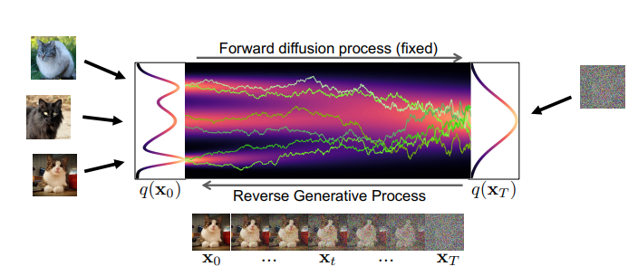
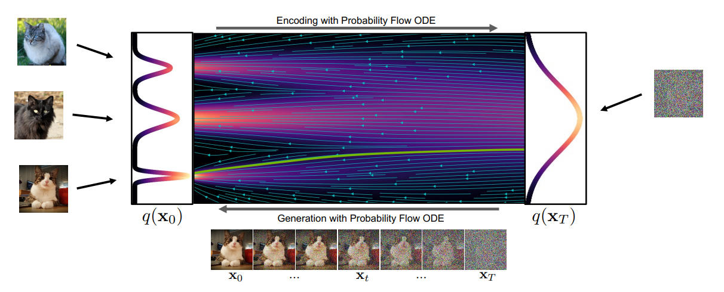

Relation of DDIM with ODE
3. Score-based Modeling
Probability flow ODE
$$dx\left(t\right)=[−\frac{1}{2}β\left(t\right)x\left(t\right)−\frac{1}{2}β\left(t\right)∇_{x}\log{q_{t}\left(x\left(t\right)\right)}]dt$$
This leads to same $q_{t}\left(x\left(t\right)\right)$ with Reverse SDE
Image Credit: Copyright (c) 2023 cvpr2023-tutorial-diffusion-models (MIT license)

Slide 31



Relation of DDIM with ODE
3. Score-based Modeling
Prove: DDIM is the discrete time Euler approximation for above ODE.
Probability flow ODE
$$dx\left(t\right)=[−\frac{1}{2}β\left(t\right)x\left(t\right)−\frac{1}{2}β\left(t\right)∇_{x}\log{q_{t}\left(x\left(t\right)\right)}]dt$$
Discrete grid
$$t_{k}= \frac{k}{T}, ∆t=t_{k}−t_{k−1}= \frac{1}{T}$$
Euler discretization
$$x_{k−1}=x_{k}−\frac{1}{2}[β\left(t_{k}\right)x_{k}+β\left(t_{k}\right)∇_{x}\log{q_{k}\left(x_{k}\right)}](−∆t)$$
$$x_{k−1}=x_{k}+\frac{1}{2}[β_{k}x_{k}+β_{k}∇_{x}\log{q_{k}\left(x_{k}\right)}]$$
Image Credit: Copyright (c) 2023 cvpr2023-tutorial-diffusion-models (MIT license)

Slide 32





Relation of DDIM with ODE
3. Score-based Modeling
$$x_{k−1}=x_{k}+\frac{1}{2}[β_{k}x_{k}+β_{k}∇_{x}\log{q_{k}\left(x_{k}\right)}]$$
$$∇_{x}\log{q_{k}\left(x_{k}\right)}=−\frac{1}{\sqrt{1−\overline{α_{k}}}}ε_{θ}(x,k)$$
Let
$x_{k−1}= { x}_{k}+\frac{1}{2}\left[β_{k}x_{k}−β_{k}\frac{1}{2\sqrt{1−\overline{α_{k}}}}ε_{θ}\left(x,k\right)\right]=$ $x_{k}+\frac{1}{2}β_{k}\left[x_{k}−\frac{1}{2\sqrt{1−\overline{α_{k}}}}ε_{θ}\left(x,k\right)\right]$
$=$ $(1+\frac{1}{2}β_{k}) x_{k}$ $−\frac{β_{k}}{2\sqrt{1−\overline{α_{k}}}}ε_{θ}\left(x,k\right)$
$≈$ $\frac{1}{\sqrt{α_{k}}}x_{k}$ $−\frac{β_{k}}{2\sqrt{1−\overline{α_{k}}}}ε_{θ}\left(x,k\right)$
$=$ $\frac{1}{\sqrt{α_{k}}}(x_{k}$ $−\frac{\sqrt{α_{k}}β_{k}}{2\sqrt{1−\overline{α_{k}}}}ε_{θ}\left(x,k\right)$)
When plugging in $x_{0}$ formula, this leads to same DDIM reverse
Image Credit: Copyright (c) 2023 cvpr2023-tutorial-diffusion-models (MIT license)

Slide 33
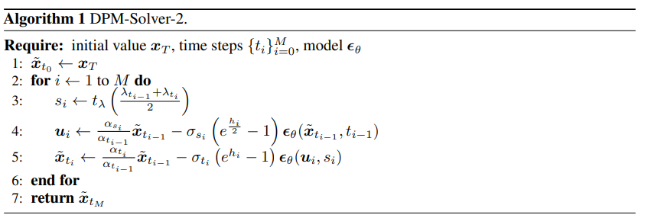
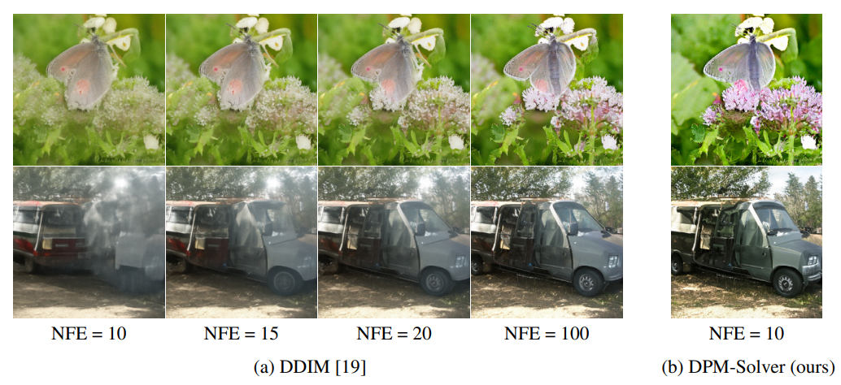
Other SDE/ODE solvers could be utilized
3. Score-based Modeling
DPM-Solver(Lu et al., 2022)
Euler method (ODE)
Euler-Maruyama (SDE)
Runge-Kutta (ODE)
Heun’s method (ODE)
DPM-Solver
…
Ref: Lu et al., “DPM-Solver: A Fast ODE Solver for Diffusion Probabilistic Model Sampling in Around 10 Steps”, (NeurIPS 2022).

Slide 34
Next week
Week 6
Various diffusion spaces
Diffusion models for discrete space
Diffusion for latent space
DiT (Diffusion transformers)
Week 7
Technical components
Conditional generation (classifier guidance, CFG)
Noise schedule
Distillation, consistency models

